Slide 1
“It seemed so DANGEROUS! You’ve got to have MOTHBALLS to do that!”
Howie Mandel

Slide 2
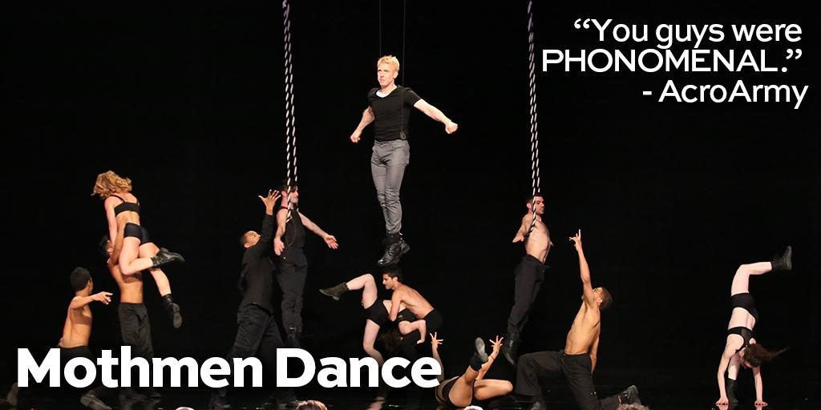
“I absolutely LOVED it! I would see it AGAIN and AGAIN and AGAIN and AGAIN!”
Mel B

Slide 3
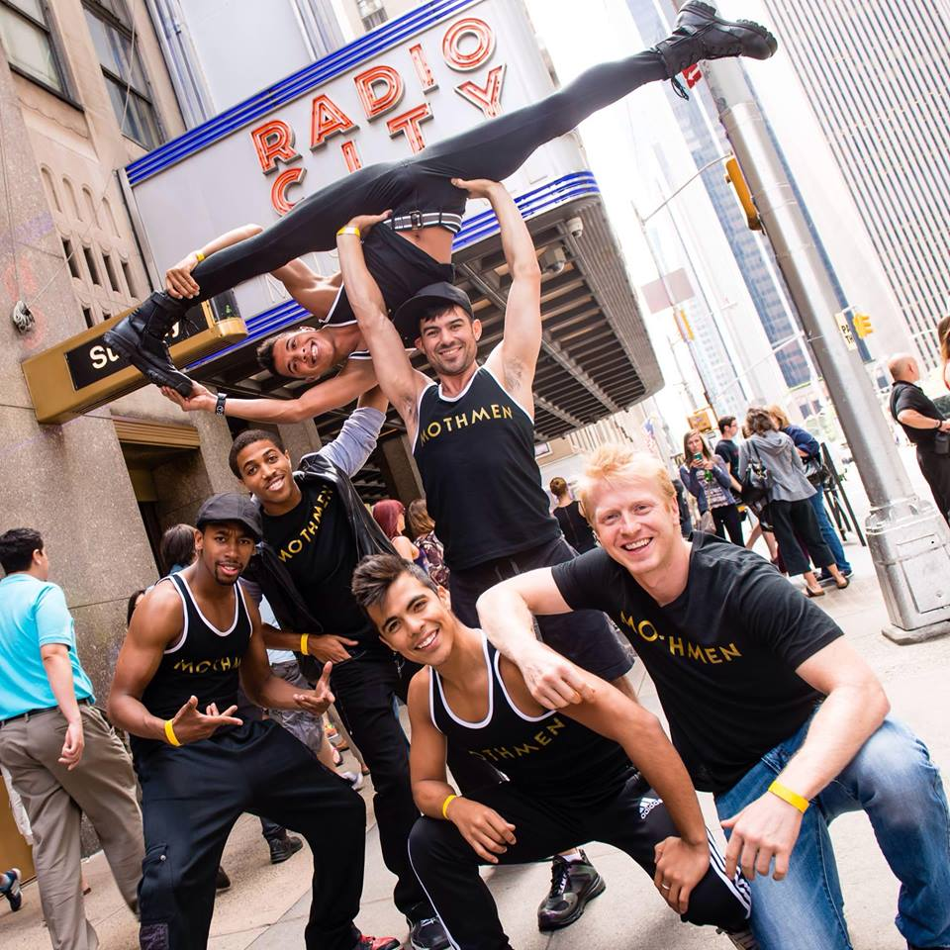

Slide 4
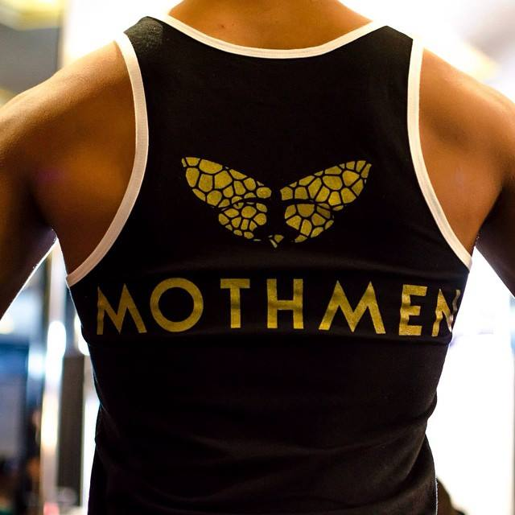
WHO ARE THE MOTHMEN?
THE MOTHMEN (produced by On the FLY Productions), as seen on the Finals of America’s Got Talent, is a high-flying, cutting edge entertainment with a cast of aerialists, dancers, flyers and
acro-artists hailing
from all over the country.
Edgy, crazy, intense, and sexy is the best way to describe this group of self professed aerial animals. MOTHMEN love being the center of attention, can be found climbing on anything from buildings to playground equipment to practice, and live to perform.
In the past five years, THE MOTHMEN have been on AGT & TruTV's Fake Off, NBC’s Little Big Shots and toured the world with their dynamic & high flying act(s)!

Slide 5
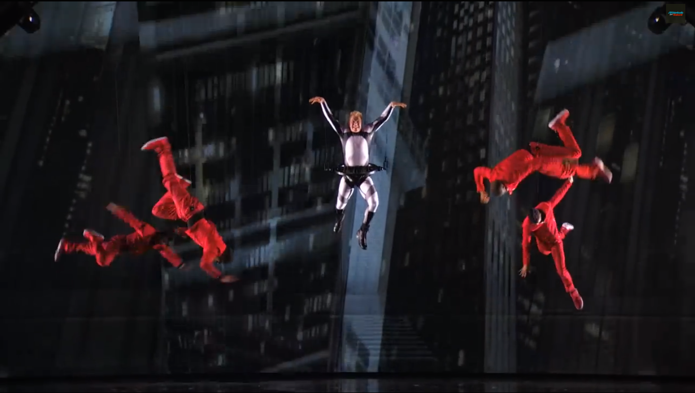
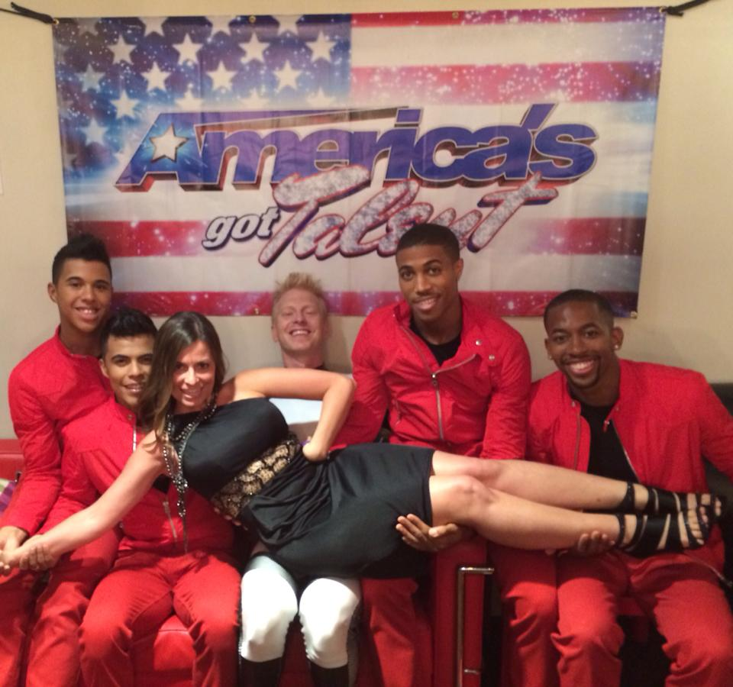
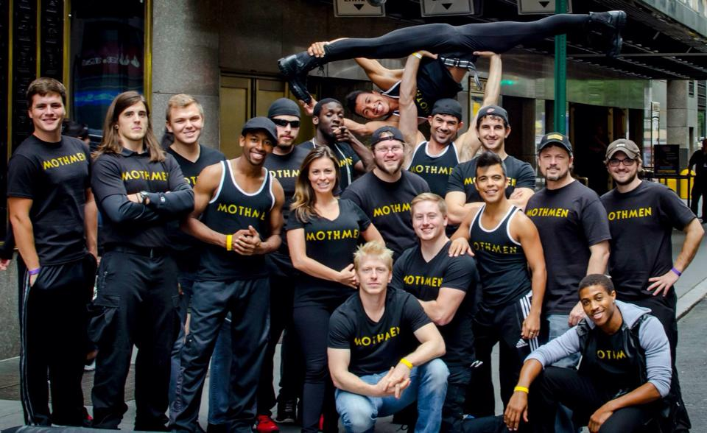

Slide 6
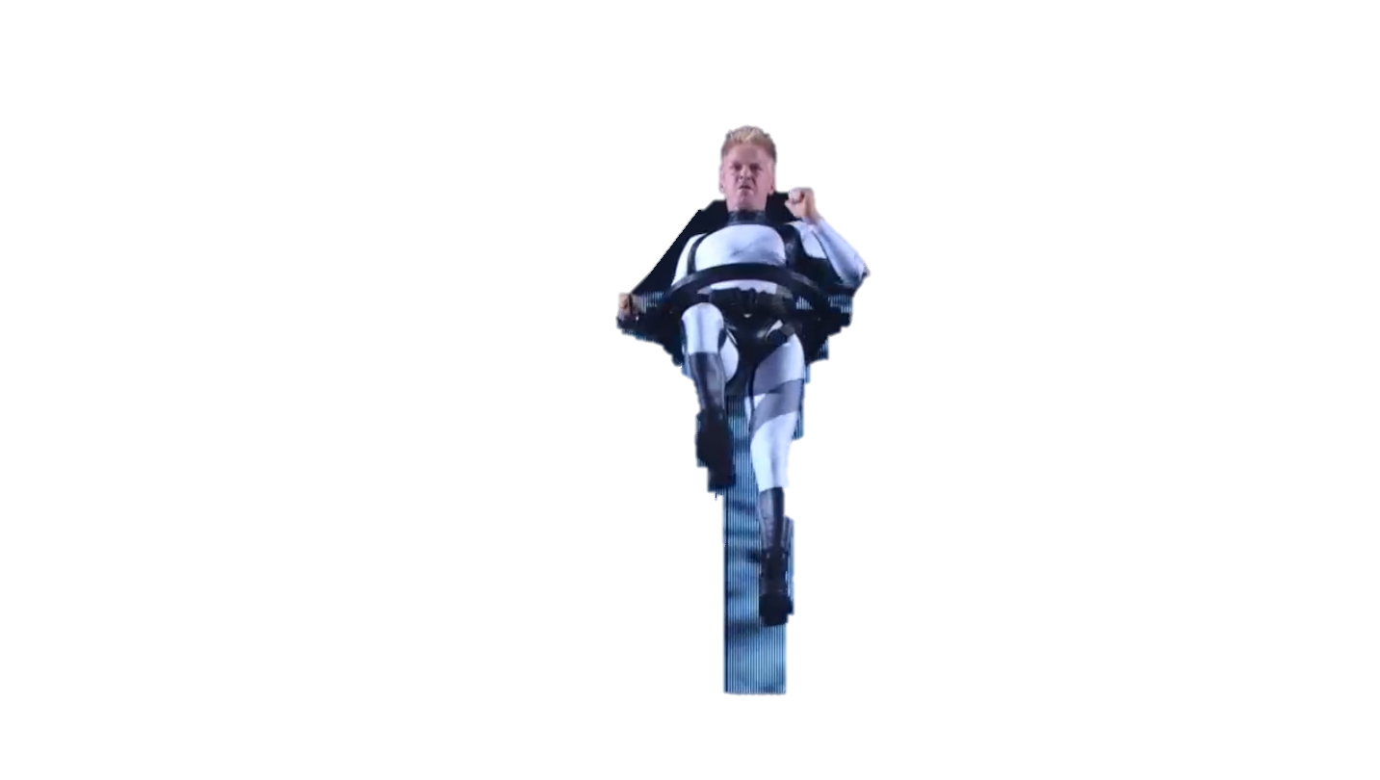
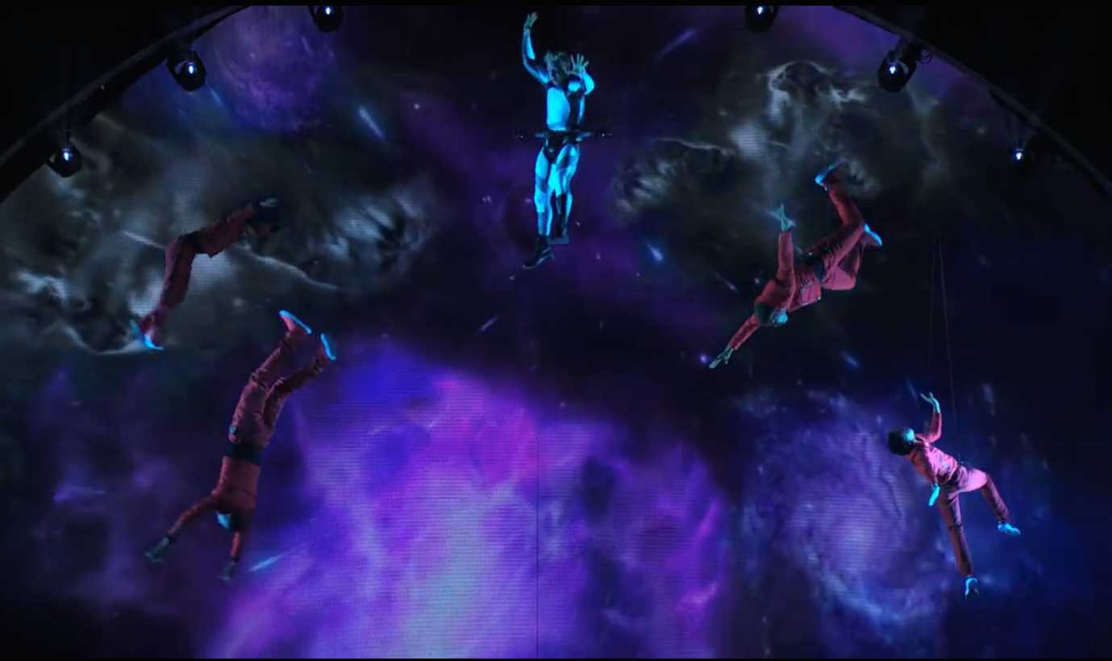
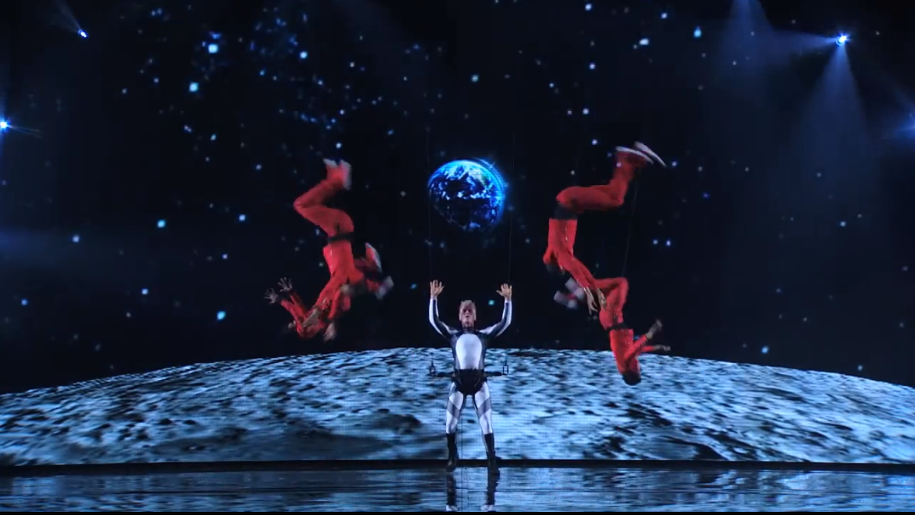

Slide 7
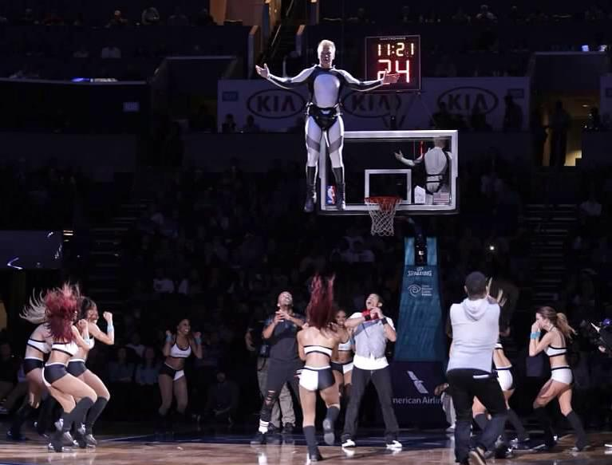
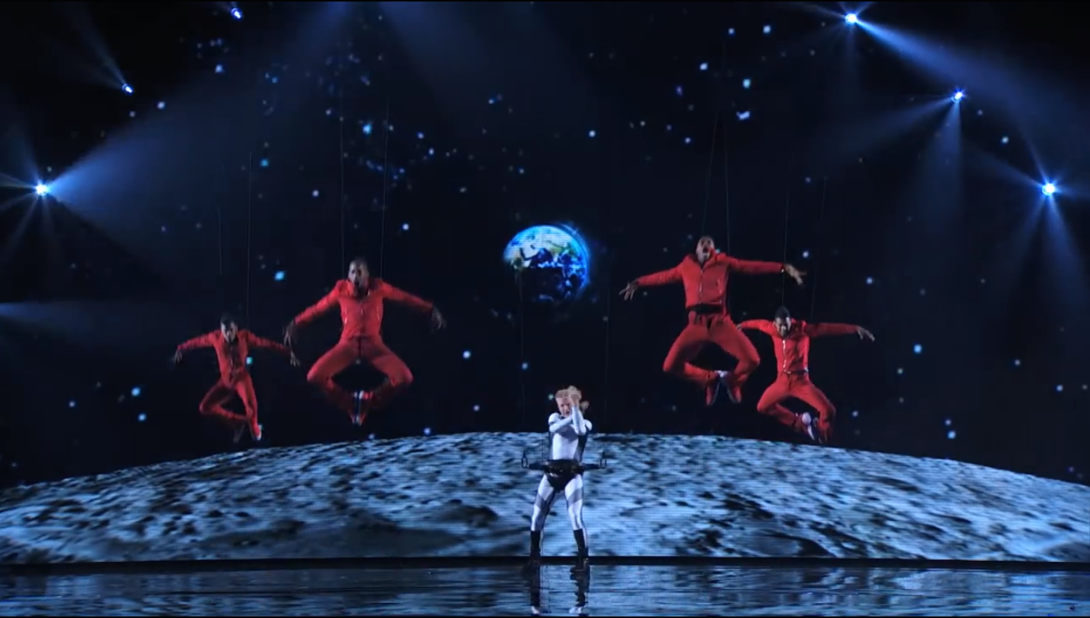
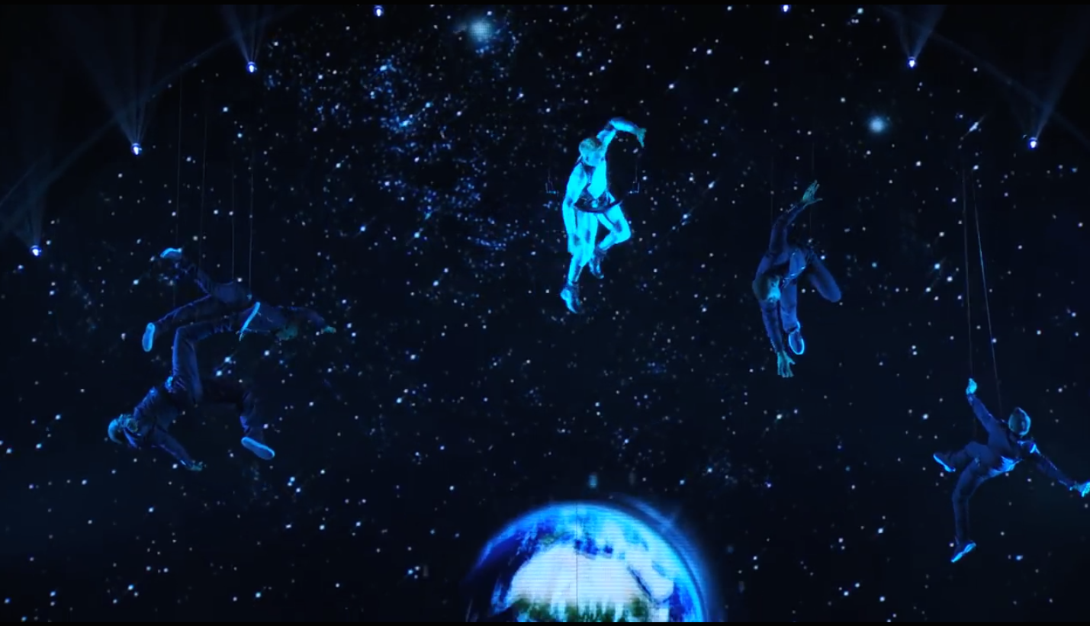

Slide 8
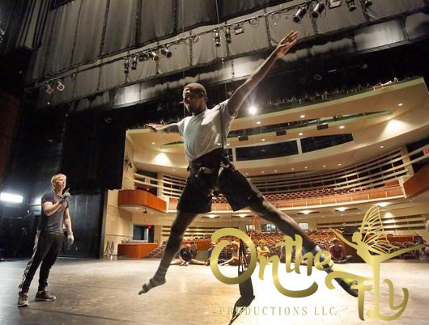
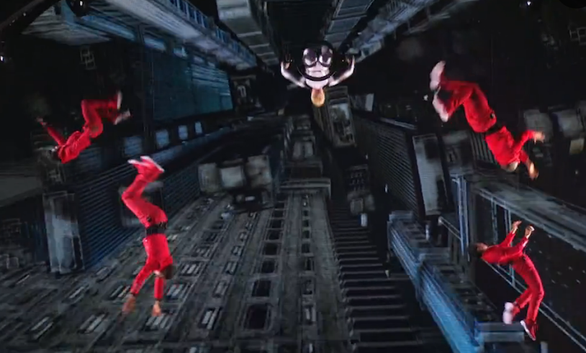

Slide 9
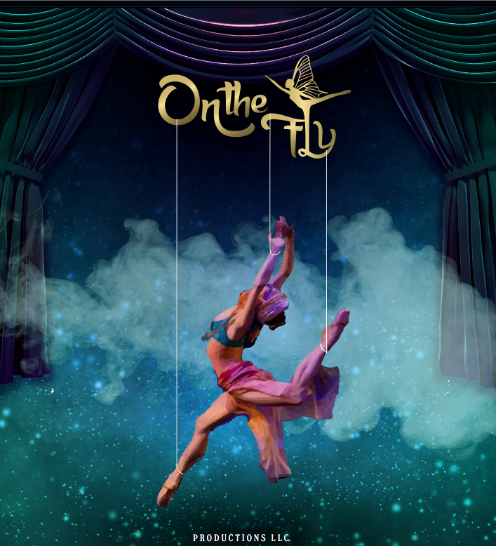
CONTACT & BOOKING INFORMATION
On the FLY Productions
855.95.ONTHEFLY
info@ontheflypros.com
www.ontheflypros.com

